Slide 1
论文分享
汇报人：孙华琴
日期：2021年06月17日

Slide 2
Neural constraints on learning
Phenomenon：Some behaviours are easier to learn than others
Hypothesis：the ease or difficulty with which an animal can learn a new behaviour is determined by the current properties of the networks of neurons governing the behaviour.
Methods：neural population activity patterns comprise a low-dimensional subspace (termed the intrinsic manifold) within the neural space. The intrinsic manifold presumably reflects constraints imposed by the underlying neural circuitry.
Result：
learn proficiently using neural activity patterns within the intrinsic manifold；
learn less proficiently using neural activity patterns outside the intrinsic manifold；
Conclusion and contribution:
existing structure of a network can shape learning which means that we are more readily able to learn new skills when they are related to the skills that we already possess
offer a network-level explanation for the observation
Notes:
电极相对于周围脑组织的微小移动，以及细胞丢失和疤痕组织的形成会造成神经记录不稳定,从而影响解码器的性能

Slide 3
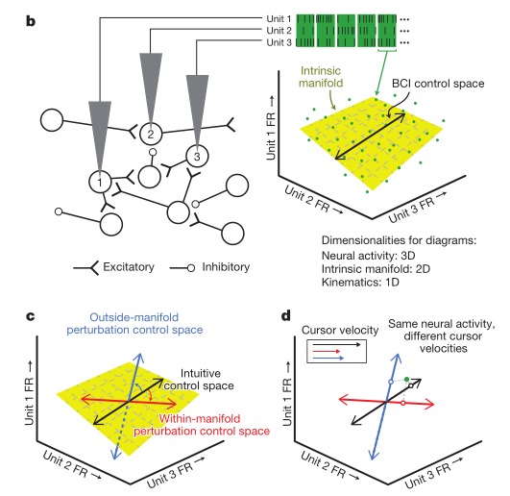
Within and outside intrinsic manifold
High-dimensional space of original neural space:
Exits co-modulate due to an indirect inhibitory connection. Such co-modulations among neurons mean that neural activity does not uniformly populate the neural space
low-dimensional space:
captured the natural patterns of co-modulation among the recorded neurons.
change the BCI mapping so that the control space was either within or outside of the intrinsic manifold
Within：
re-orienting the intuitive control space but keeping it within the intrinsic manifold preserved the relationship between neural units and co-modulation patterns,
altered the way in which co-modulation patterns affected cursor kinematics (red arrows, Fig. 1a).
Outside:
re-orienting the intuitive control space and allowing it to depart from the intrinsic manifold (blue line in Fig. 1c).
altered the way in which neural units contributed to co-modulation patterns, but it preserved the way in which co-modulation patterns affected cursor kinematics (blue arrows, Fig. 1a).

Slide 4
Methods
Estimation of the intrinsic manifold
factor analysis
The central idea is to describe the high-dimensional population activity u in terms of a low-dimensional set of factors z.
Intuitive mappings
Kalman filter
Perturbed mappings
within-manifold perturbations
Outside-manifold perturbations
Choosing a perturbed mapping
a set of candidate perturbations.
predicted the open-loop cursor velocities for each candidate perturbation.
selected one candidate perturbation such that the perturbed mapping would not be too difficult for the monkeys to use nor so easy that no learning was needed to achieve proficient performance.
Notes:
置换矩阵的每个元素不是0就是1。在一个置换矩阵的每一列和每一行中，一个元素是1，其他元素是0。 就是换了一下内在基向量的位置
外流性 换了原空间的每个channel的位置

Slide 5
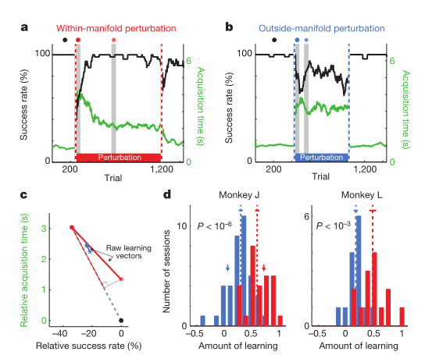
Result
Task flow
calibration block to get baseline ; perturbed block; washout block
On most days, completed one perturbation session ;On nine days, completed multiple perturbation sessions
Within manifold is easier learned compared to outside manifold(a,b)
calibration block :after the perturbed mappings were introduced, BCI performance was impaired (Fig. 2a, b, first grey vertical band).
perturbed block: Performance improved for the within-manifold perturbation (Fig. 2a) while remained impaired for the outside-manifold perturbation (Fig. 2b) showing that the animal learned to control the cursor under that mapping within-manifold but not outside manifold.
washout block: Following within-manifold perturbations, performance was impaired briefly indicating that learning had occurred. Following outside-manifold perturbations, performance was not impaired, which is consistent with little, if any, learning having occurred (the second dashed vertical line in Fig. 2a, b).
quantified the amount of learning(c)
statistical results of learning (d form c)
For within-manifold perturbations, the animals regained proficient control of the cursor indicating that they could learn new associations between natural co-modulation patterns and cursor kinematics.
Conclusion: the structure of a network determines which patterns of neural activity (and corresponding behaviours) a subject can readily learn to generate. Within the intrinsic manifold were more learnable than those outside of it
Notes:
A黑迹，成功率高;绿色轨迹，目标捕获时间。虚线竖线表示BCI映射何时发生更改。灰色垂直带代表50个试验箱，用于确定初始(红色和蓝色点)和最佳(红色和蓝色星号)的扰动映射性能
B黑点，具有直观的性能映射; ，红点和蓝点表示在引入扰动后的表现(图2a和图2b中，成功率和获取时间相对于直观映射的表现);红色和蓝色星号表示在扰动期间的最佳性能;图2a中会话的最大学习向量。每session的学习量是投影到最大学习向量上的原始学习向量的长度，由最大学习向量的长度归一化。这是细红线的长度与虚线的长度之比
C所有session的学习量。1表示完全学习了神经活动和运动学之间的关系，0表示没有学习。箭头表示图2a(红色)和图2b(蓝色)所示的session。虚线，分布的平均值;实线，均值加了标准差

Slide 6
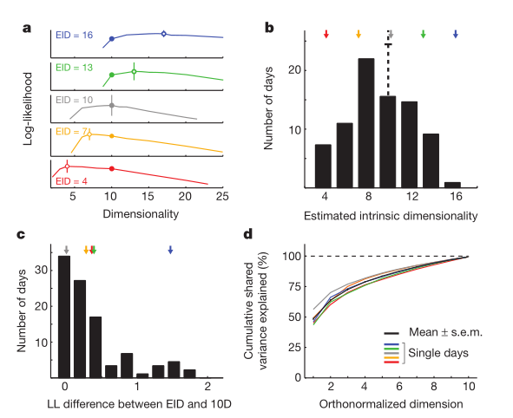
Result
Prove the rationality of dimension 10
estimated dimensionalities ranged from day to day（a）
the average dimensionality was about ten (b).
the selection of ten dimensions still provided a model that was nearly as good as the best model (c).
the top few dimensions captured the majority of the co-modulation among the neural units (d), we could have selected a different dimensionality within the range of near-optimal dimensionalities and still attained similar
Notes:
A不同天的population activity不同颜色。 峰值(开圆)表示估计的内在维数(EID)。竖条表示对数似然的标准误差，通过四个交叉验证折叠计算。所有实验(实心圆)均采用十维内蕴流形。
B 统计分析EID所有日子和两个猴子
C十维(10D)模型的LL与EID模型的差异。横轴是最优dim的std，说明取10维的时候得到的差异在一个std内
D累积共享方差由实验中使用的十维本征流形解释。

Slide 7
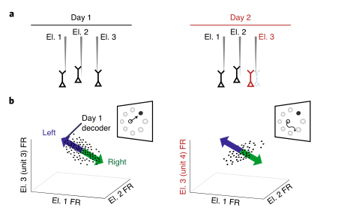
Stabilization of a brain–computer interface via the alignment of low-dimensional spaces of neural activity
Phenomenon： neural recording instabilities caused by small movements of the electrodes relative to the surrounding brain tissue, as well as cell loss and scar tissue lead the BCI to become uncontrollable
Hypothesis：neural population activity tends to lie within a low-dimensional space, termed the neural manifold, which are quite stable for the constraints imposed by the underlying neural circuitry
Methods：developed a manifold-based stabilizer to align estimates of the manifold, a decoder with a fixed parameters can then be used to accurately estimate intended BCI movements
Result：solve such as tuning changes, drop-outs or baseline shifts without knowledge of the user’s intended BCI movements
Notes:
电极相对于周围脑组织的微小移动，以及细胞丢失和疤痕组织的形成会造成神经记录不稳定,从而影响解码器的性能

Slide 8
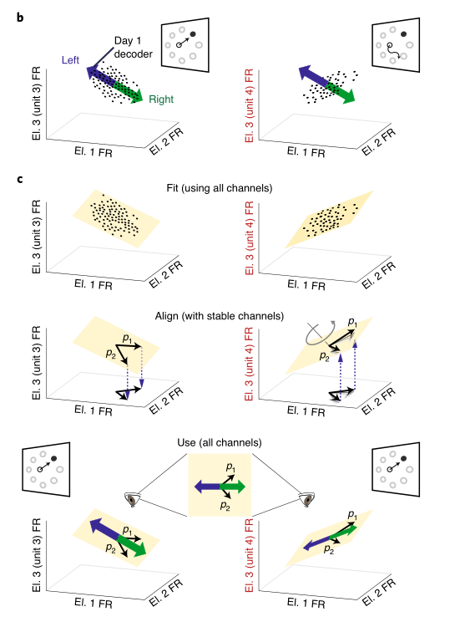
Manifold-based stabilization intuition and design.
neural recording instabilities
Electrodes 1 and 2 are stable across days 1 and 2 whereas electrode 3 is unstable
estimating a manifold
estimating a manifold from the recorded population activity at different times
align the manifolds across time
identify the electrodes with stable recordings
specify that the coordinate axes
align manifold by rotation matrix
Passed aligned manifold to the decoder
Notes:
电极相对于周围脑组织的微小移动，以及细胞丢失和疤痕组织的形成会造成神经记录不稳定,从而影响解码器的性能

Slide 9
Methods-Stabilization and decoder.
Neural stabilizer
get a manifold by factor analysis
align manifold by rotation matrix
get stabilized estimates of latent state
Decoder
Kalman filter
Identifying stable electrodes.
electrodes with corresponding rows of either Λ1 or Λ2 with l2 norms less than a threshold, T, are first removed which could exclude electrodes that are noisy or have experienced unit drop-out
an iterative procedure to rank and remove electrodes according to how much they have changed their relationship with the underlying manifold
Notes:
Rotation matrix 有闭式解
除非loading matrix退化，否则O是可以

Slide 10
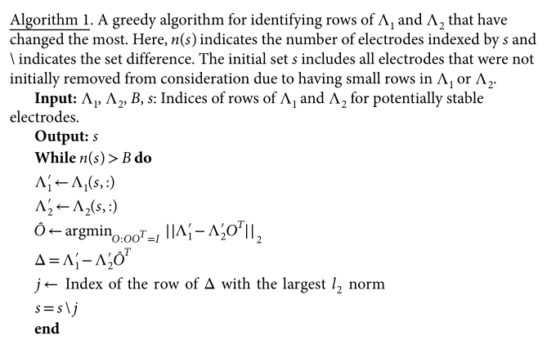
Methods-Stabilization and decoder.
Identifying stable electrodes
A greedy algorithm for identifying rows of Λ1 and Λ2 that have changed the most
the number of alignment electrodes can be viewed as an estimate of the degree of stability :high neural activity means large alignment channels
how often the stabilizer should be updated and what data should be used. 128trial

Slide 11
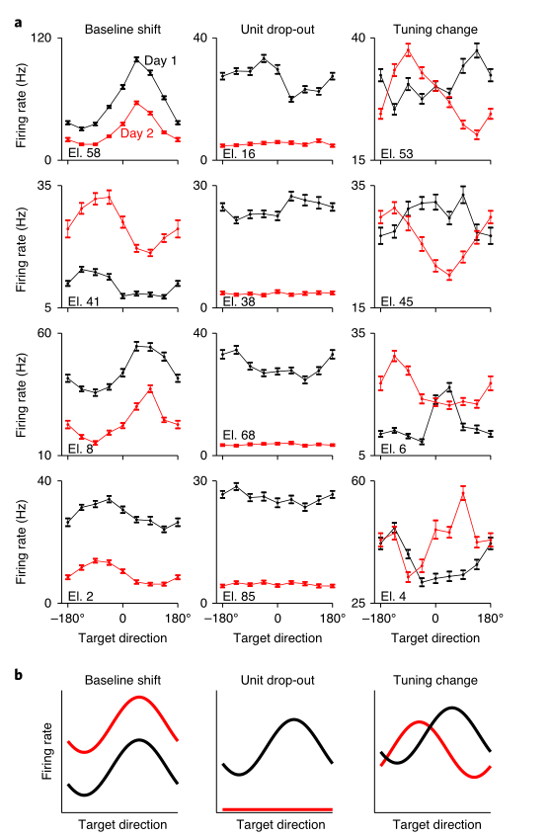
Generating neural instabilities
neural instabilities in real data(a)
Examples of differences in tuning curves during an eight-target center-out arm-reaching task across days
Generating neural instabilities
baseline shifts：adding a randomly generated constant to the binned spike count of each electrode.
unit drop-out：make 15 electrodes to zero.
tuning changes：replacing the spike count activity on 15 of the electrodes with that from a held-out electrode set.
combination instabilities：simultaneously applying a baseline shift to all electrodes ,a unit drop-out instability to five electrodes and a tuning change instability to ten electrodes
Notes:
Tuning 替换成固定的一组held-out electrode

Slide 12
result
Stabilization overcomes severe and abrupt recording instabilities（single day）
Stabilization enables stable multiday performance instabilities
Stabilization can outperform supervised recalibration
Notes:
垂直虚线表示稳定器更新。
在这个区块中，黑点表示成功率和平均获取时间，这些数据是在稳定器更新之间的所有试验中计算出来的，通常每16次试验一次。对于成功率小于50%的区块，采集时间没有被量化，而是用红点表示。为了直观，评估块的平均成功率和获取时间显示在每个跟踪的右侧。

Slide 13
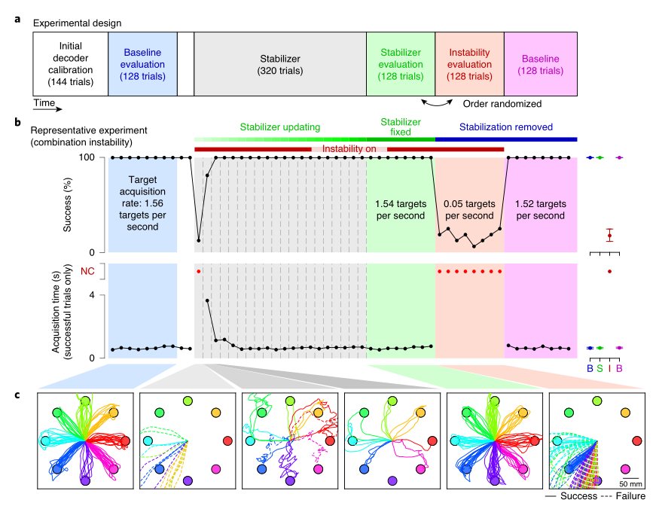
Stabilization overcomes severe and abrupt recording instabilities
calibration session
Performance was typically high
the monkey performed 128 trials of BCI control using the calibrated decoder in the absence of instabilities.
stabilizer block
introduced a recording instability and Performance decreased (c, second panel))
updating the parameters of the stabilizer every 16 trials (b, grey region). rapidly improved performance; cursor trajectories became straighter and more consistent with subsequent updates (c, third and fourth panels)
Evaluation block
Stabilizer fix: comparable performance to baseline
Stabilizer removed: comparable performance to introduced instability immediately
Notes:
垂直虚线表示稳定器更新。
在这个区块中，黑点表示成功率和平均获取时间，这些数据是在稳定器更新之间的所有试验中计算出来的，通常每16次试验一次。对于成功率小于50%的区块，采集时间没有被量化，而是用红点表示。为了直观，评估块的平均成功率和获取时间显示在每个跟踪的右侧。

Slide 14
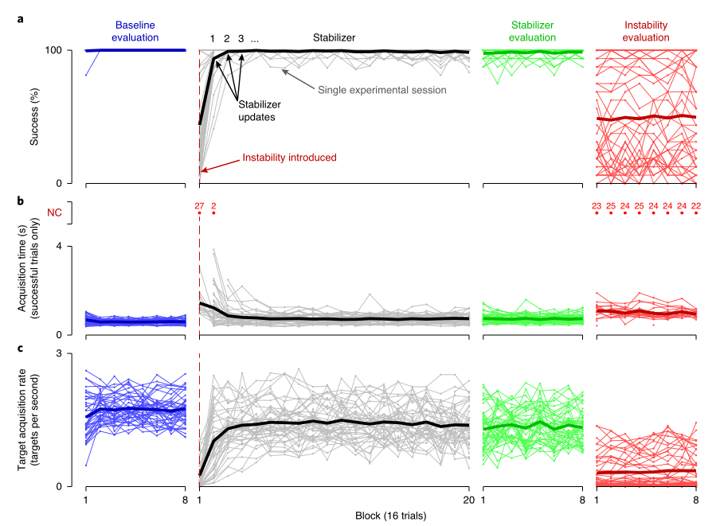
results across 42 single-day experiments
Three metrics to quantify performance
Introduce TAR
Conclusion:
introducing the recording instability resulted in a significant decrease in performance
The stabilizer restored performance

Slide 15
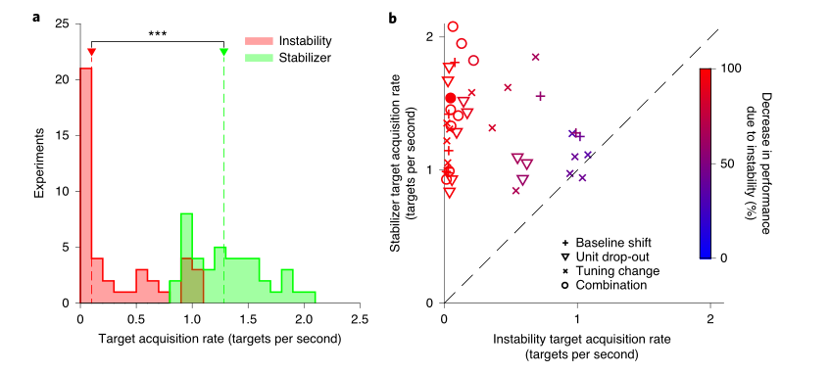
statistical result of single day performance
TARs were significantly higher when the stabilizer was used （a）
stabilizer improved performance in most experiments (b，points away the dashed line)
Similar performance is due to the small impact instabilities on BCI performance (b, points near the dashed line).
Notes:
右图
颜色表示用不稳定因素对decoder的影响 位置表示在不稳定时用稳定器和不用稳定器之间的差距

Slide 16
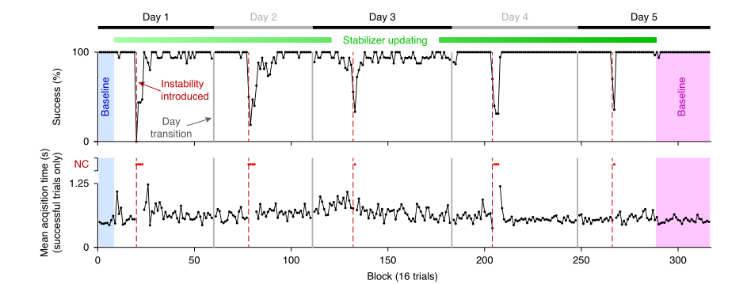
Stabilization enables stable multiday performance instabilities
neural instabilities resulted in declines in performance
stabilizer rapidly restoring control
Performance recovery occurred more gradually during the multi-day experiments than the single-day experiments
Notes:
垂直虚线表示稳定器更新。
在这个区块中，黑点表示成功率和平均获取时间，这些数据是在稳定器更新之间的所有试验中计算出来的，通常每16次试验一次。对于成功率小于50%的区块，采集时间没有被量化，而是用红点表示。为了直观，评估块的平均成功率和获取时间显示在每个跟踪的右侧。
在 5 天的持续 BCI 控制期间使用稳定剂
多重不稳定性被应用于神经活动。
然后打开稳定器并允许使用最近记录的神经活动的滑动缓冲区连续运行。
我们消除了所有应用的不稳定性，并使用初始非稳定解码器进行了一组试验。

Slide 17
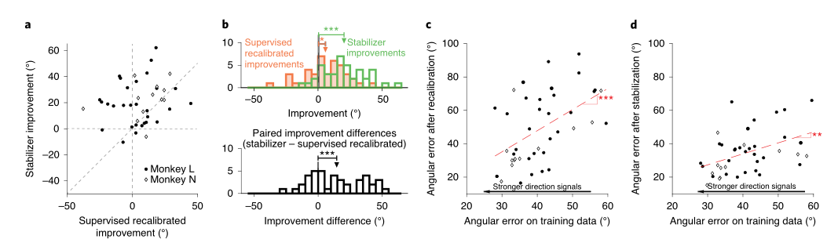
Stabilization can outperform supervised recalibration
Objective: stabilizer is able to counteract neural recording instabilities even when the user is not actively engaged or attempting to use the BCI.
Method: compare to supervised recalibration method
Result:
Performer of decoder:
The number of improvement experiments : stabilizer win(a)
The average improvement : stabilizer win(b top); mean of the distribution of paired difference is significantly different(b, bottom)
Relation between performance and the strength of cursor movement direction signals
Stabilizer is weak while supervised is strong
Notes:
用角误差对监督再校准和稳定性能进行了量化。角度误差定义为每个估计的运动方向矢量(稳定器和监督重新校准)和oracle运动方向(见方法)之间的角度。
与稳定校准相比，监督校准的较低表现表明，由于不稳定的严重程度，当BCI表现较低时，动物不再完全参与任务。在这种情况下，动物可能不打算控制光标，导致监督重新校准表现不佳。相比之下，由于稳定不依赖于对用户意图的估计，因此在低投入任务期间，当神经活动中的方向性信息量可能较低时，它仍然可以很好地发挥作用。

Slide 18
感谢聆听！

